Slide 1

Slide 1
Rental Rates and Employment
Team Members:
Randall, Amber, & Josue

Slide 2

Slide 2
Analysis of Housing Rental Market
Question To Answer:
Is there any correlation with rental rate costs with unemployment rate and/or median household income?
What other factors might impact the Rental Market?
2

Slide 3


The Data
U.S. Bureau Of Labor Statistics
3 Datasets selected for evaluation
2 Datasets used for final analysis
Zillow.com
56 Datasets were initially curated from Zillow
14 Datasets selected for inclusion in the data exploration phase
8 Datasets were used for final analysis
We explored the BLS API and pulled some data. However, the API was going to require more custom development that the time was allotted.

Slide 4

Data Exploration (Journey)
Jupyter Notebook was utilized to perform all of the data exploration.
All data was imported into pandas dataframes
Created several visualizations in the initial process to get a feel of the data
The data was from 2013 – 2018 at the City level. Except Unemployment and Median Income was at the State level
We made the decision to aggregate everything to a common dataset by Year, Month and Quarter for the analysis
Additional data was retained at city level and outside the year range for further opportunities

Slide 5

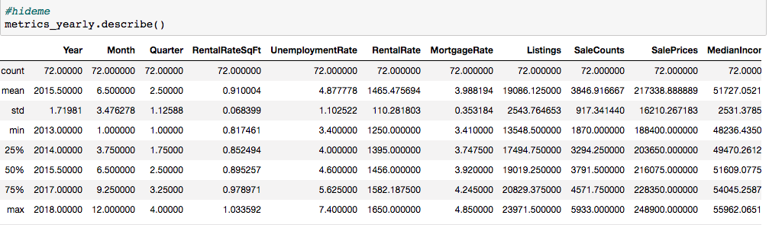
Follow The Data (Analysis)
All data was curated into a single dataframe, then we were able to apply multiple visualization.

Slide 6
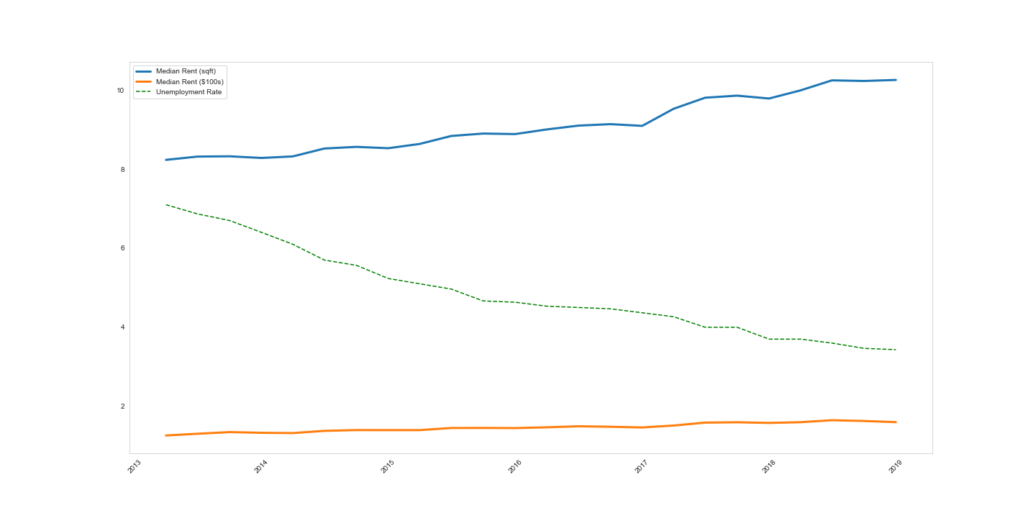
Follow The Data (Analysis)
Started with the core questions by plotting RentalRateSqFt as our primary metric against Unemployment and Median Income
Rental Rates vs Unemployment by Year
Rental Rates
2013 – $1,300
2018 – $1,600 (23% increase)
Unemployment Rate
2013 – 6.2%
2018 – 3.5% (77% decrease)

Slide 7
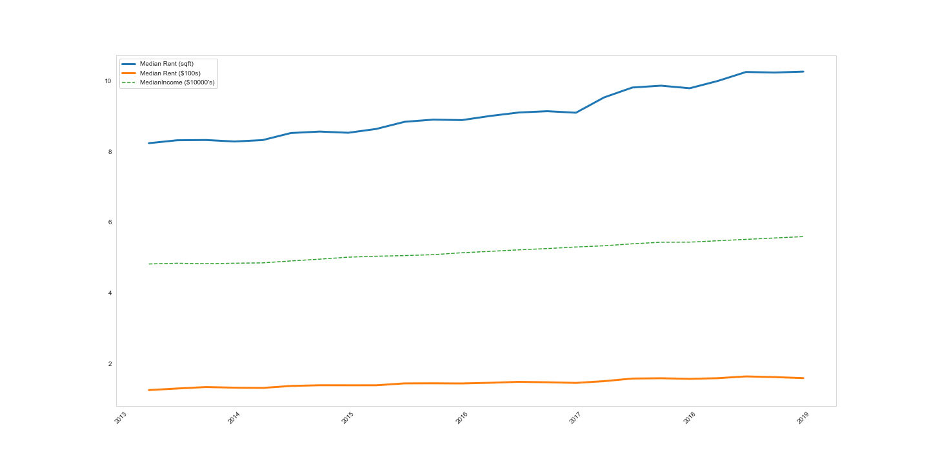
Follow The Data (Analysis)
Rental Rates vs Median Income by Year
Rental Rates
2013 – $1,300
2018 – $1,600 (23% increase)
Median Income
2013 – $48,236
2018 – $55,962 (16% increase)

Slide 8
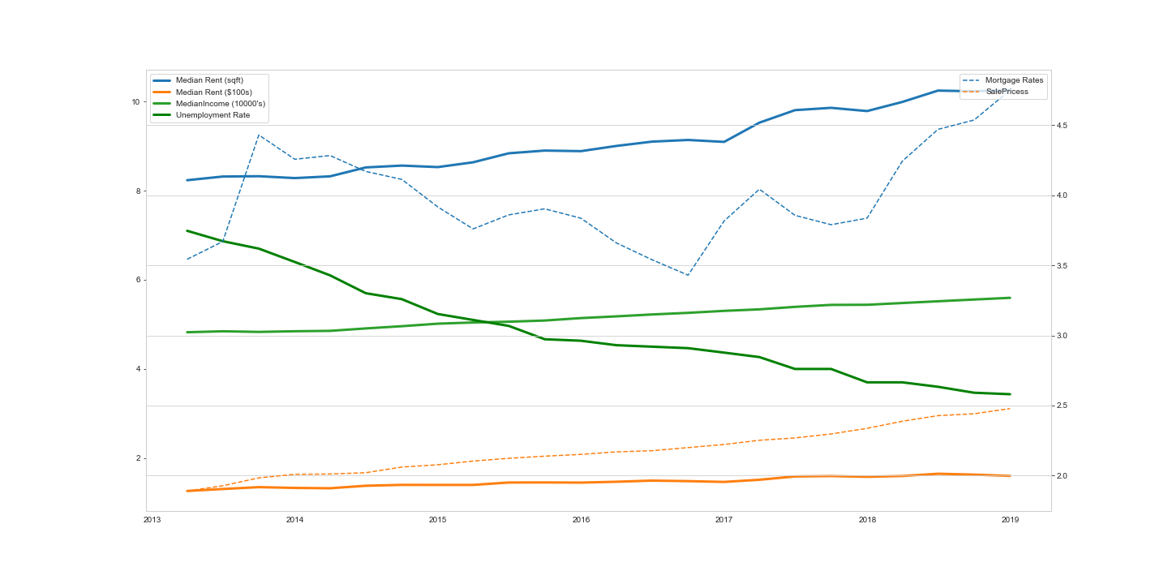
Follow The Data (Analysis)
Plotted all data together
Rental Rates vs All Observations
Rental Rates
2013 – $1,300
2018 – $1,600 (23% increase)
Median Income
2013 – $48,236
2018 – $55,962 (16% increase)
Unemployment Rate
2013 – 6.2%
2018 – 3.5% (77% decrease)
Mortgage Rates
2013 – 3.46%
2018 – 4.6%
Sale Prices
2013 - $189,500
2018 - $248,900 (31% increase)

Slide 9
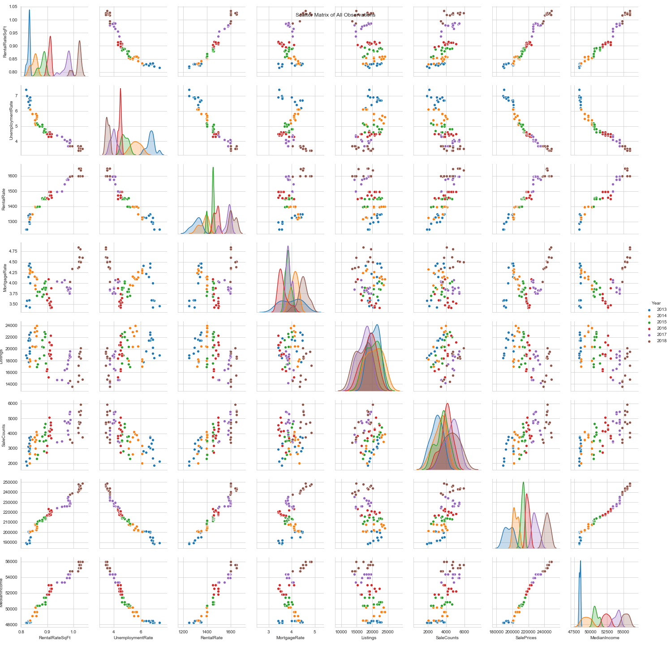
Follow The Data (Analysis)
Scatter Matrix was then plotted across all observations to look for clear signals

Slide 10
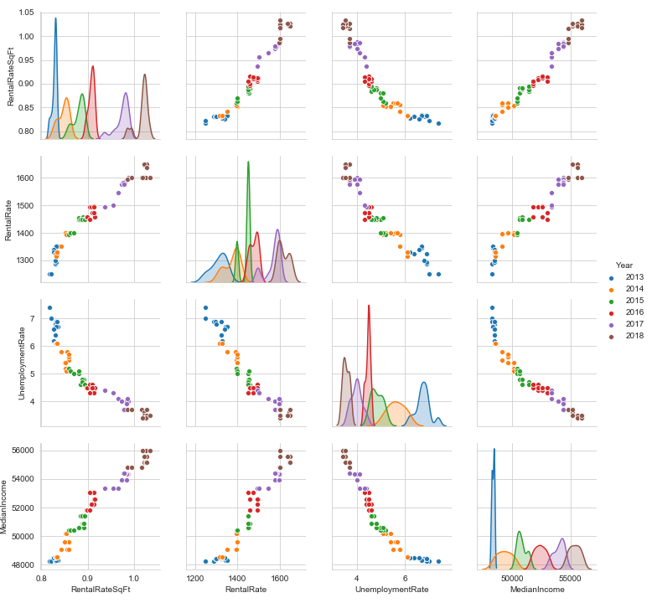
Follow The Data (Analysis)
Scatter Matrix focused on our core metrics

Slide 11
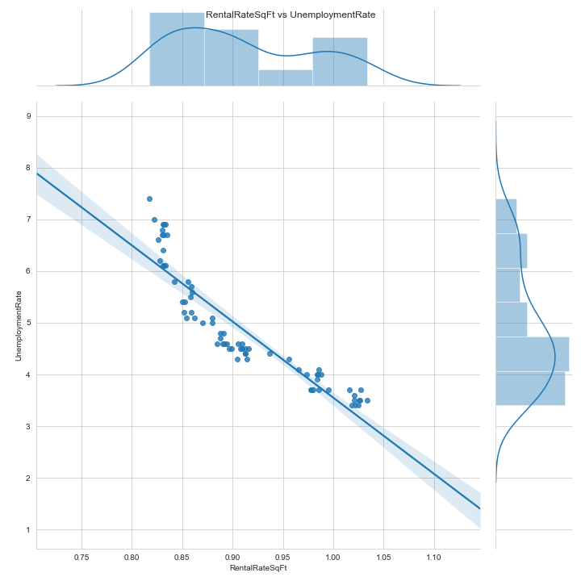
Follow The Data (Analysis)
RentalRateSqFt vs UnemploymentRate - Regression
Jointplot with regression to provide additional support to our finding

Slide 12
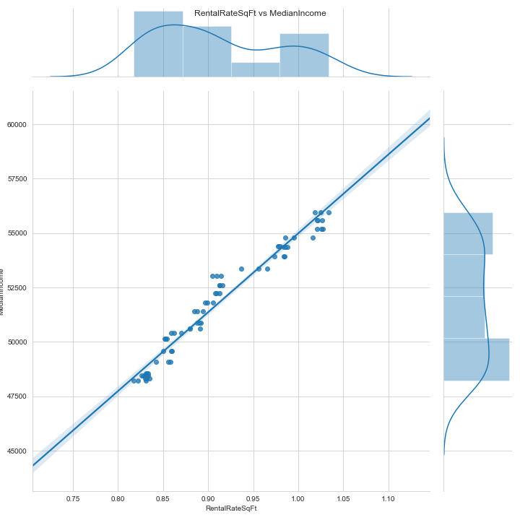
Follow The Data (Analysis)
RentalRateSqFt vs MedianIncome - Regression
Jointplot with regression to provide additional support to our finding

Slide 13
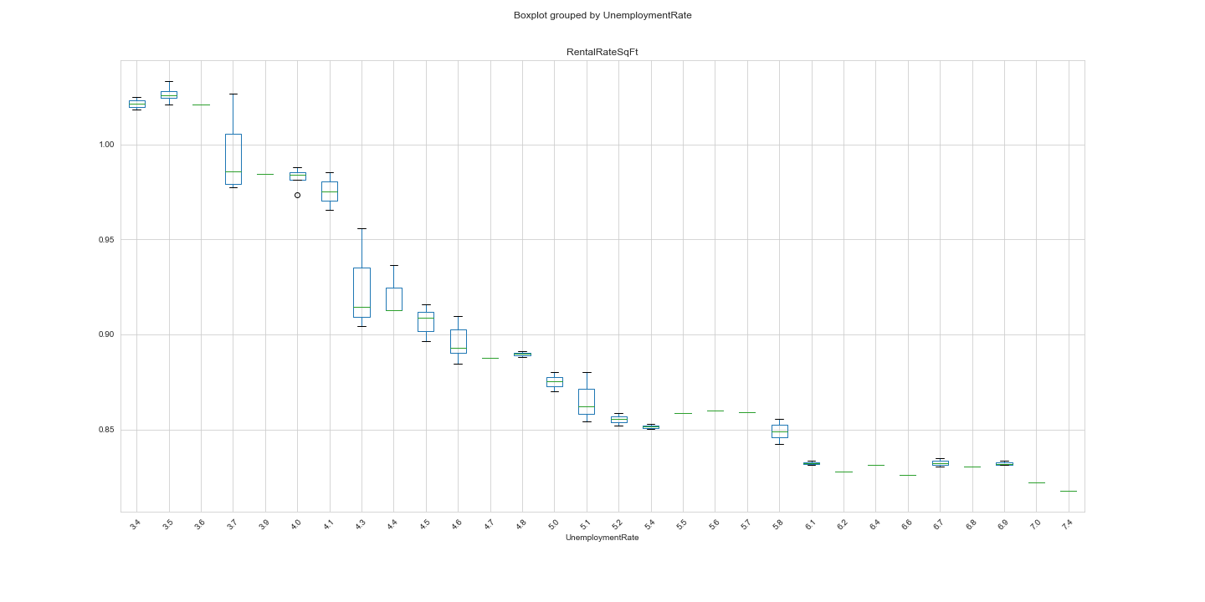
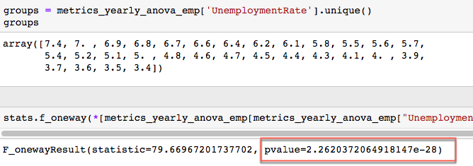
ANOVA Testing of Hypothesis
Null Hypothesis “Unemployment Rates has no correlation to Rental Rates”

Slide 14
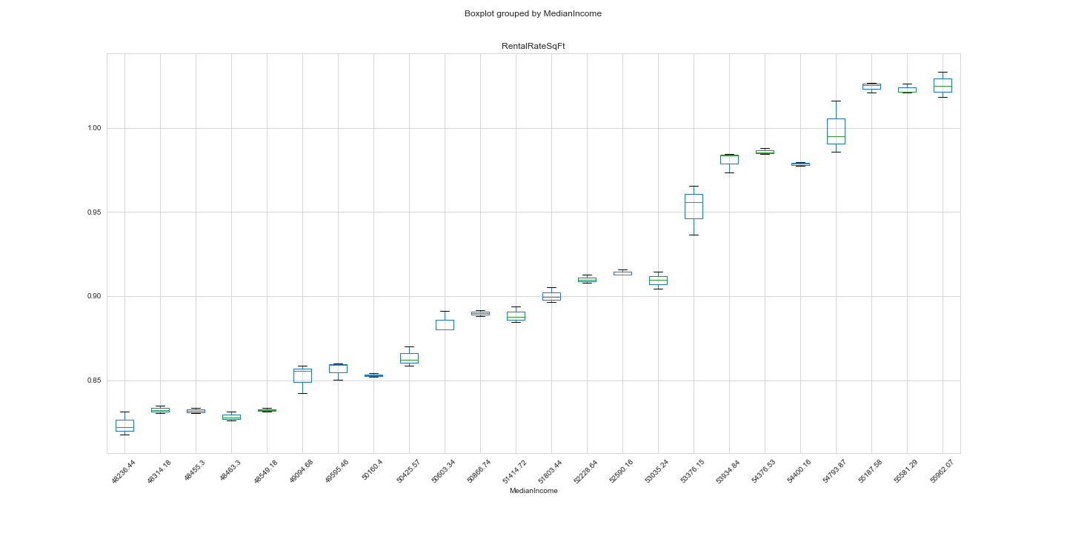
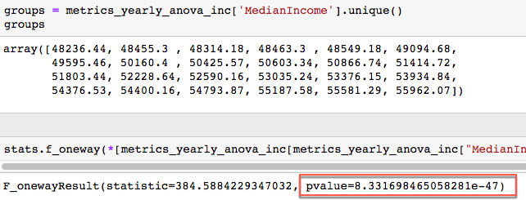
ANOVA Testing of Hypothesis
Null Hypothesis “Median Income has no correlation to Rental Rates”

Slide 15

Questions

Slide 16
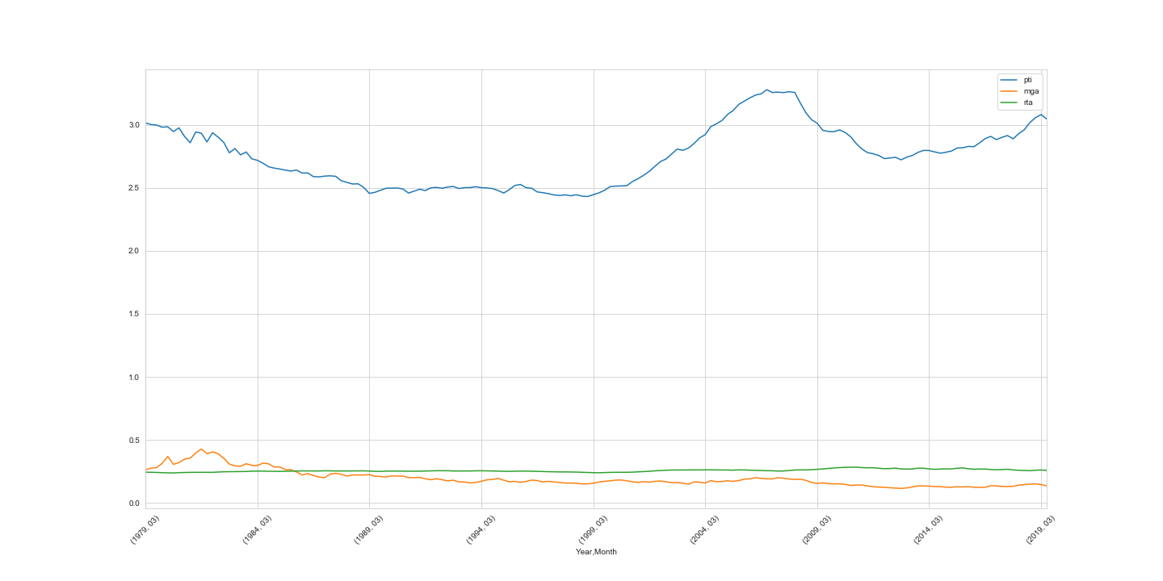
Additional Observations – Affordability Index

Slide 17
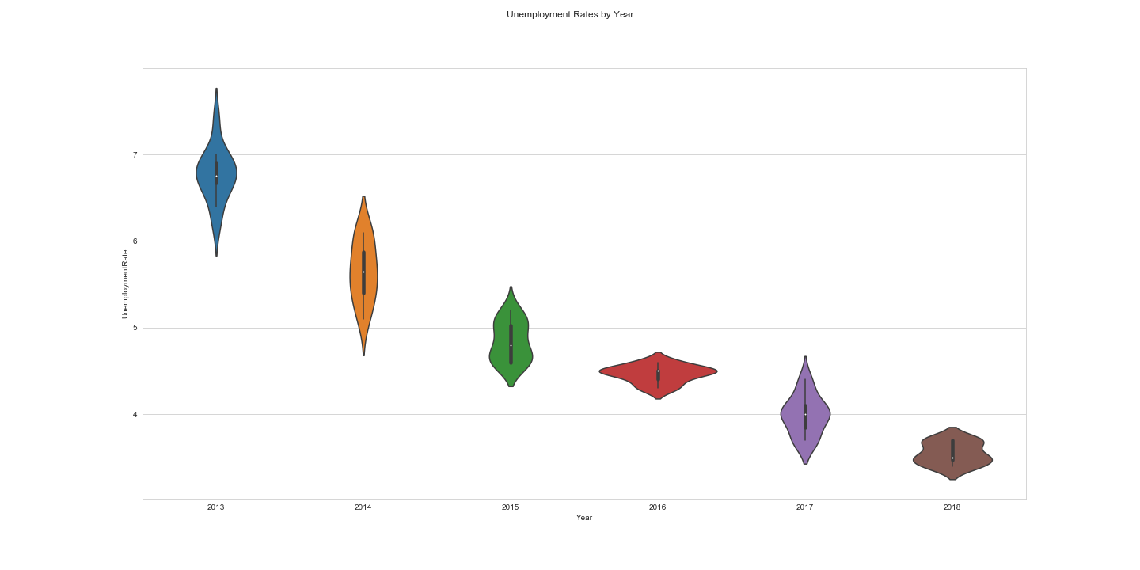
Unemployment Rates by Year – Violin Plots

Slide 18
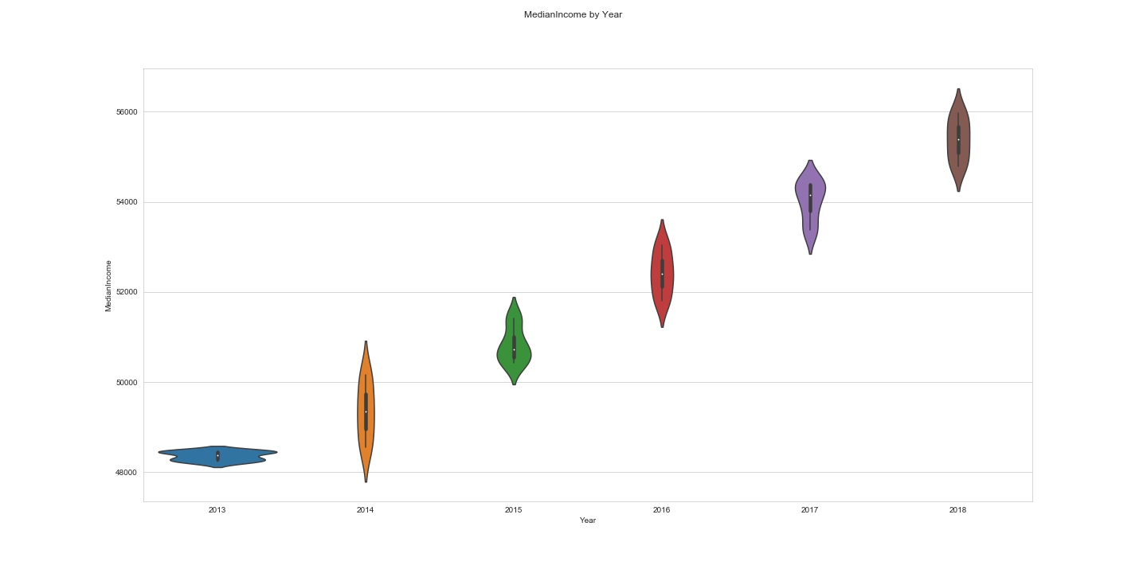
Median Income by Year – Violin Plots

Slide 19
Interactive Layerd Maps

Slide 20
Interactive Layerd Maps

Slide 21
Interactive Layerd Maps

